Slide 1
Location
Optimization
for Walmart
Justin Feng
Jie Ji
Shih-Hung (Angela) Ma
Kai-Ping (Rory) Wang
Vivian Yang
Fengjiao (Jenny) Zhang
Notes:
Good evening and thank you all for being here. Today my team will be presenting on a location optimization model for Walmart.

Slide 2

Agenda
1
Background
2
Problem Statement
3
Proposed Model
4
Input Data
5
Future Work
Notes:
Here’s our agenda for today. First, we’ll go over the background of our client, Walmart, and our problem statement. Then, we’ll explain our proposed model, including all the data we plan on inputting into the model and our expected output. Lastly, we’ll discuss some limitations of our model and what we can do to optimize the model moving forward.

Slide 3

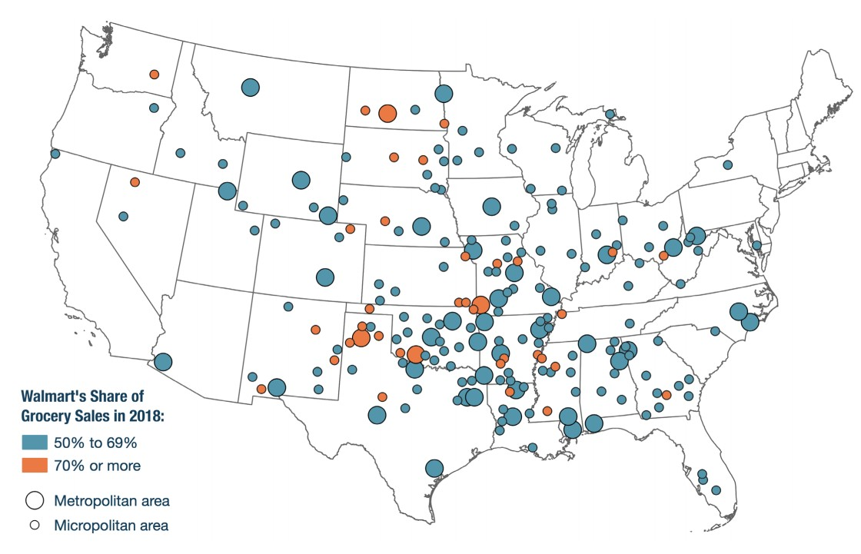
About Walmart
World's largest company by revenue; revenue in 2019 exceeded $500 billion
Captures 50%+ grocery sales in 43 metropolitan areas and 160 smaller markets in the US
Notes:
Our client, Walmart, is the largest company in the US by revenue. Their revenue in 2019 was around $514 billion dollars. Walmart is the go-to supermarket for many people both in the US and internationally. To give you a better idea of the scale of Walmart in the US, here’s a map that shows the markets where Walmart captures over 50% of all grocery sales. The orange dots mark areas where Walmart captures over 70% of all grocery sales.

Slide 4
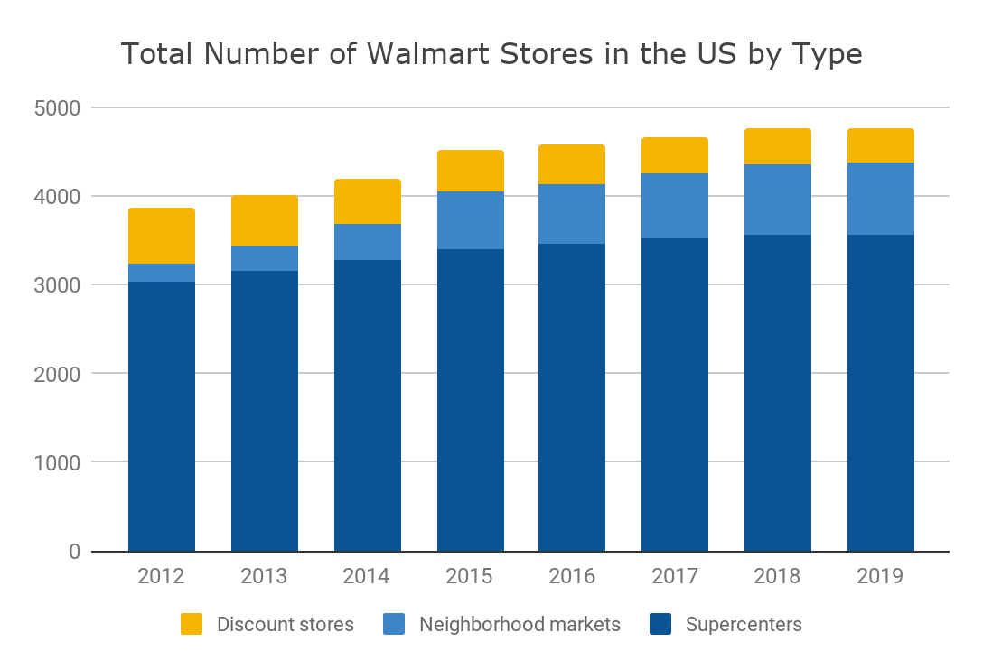
About Walmart
Currently has 4,769 stores in the US (4,761 in 2018)
Closing or has already closed 22 stores across US and Canada this year
Planning to open less than 10 stores over the next year
Notes:
Currently, Walmart has 4769 stores in the US, which is only 8 more stores than what they had from the previous year. Walmart has already closed 22 stores in the US and Canada this year, and they are only planning on opening less than 10 stores within the next year.

Slide 5

Problem Statement
How can Walmart find the best location for new stores to maximize revenue?
Notes:
The problem we’re trying to solve for Walmart is: how can they find the best location for new stores to maximize revenue? Our model will provide Walmart with a list of expected incremental revenues by zip code to help them make the optimal decision on where to open a new store.
Now I’ll pass it on to Rory to explain the model we came up with.

Slide 6
Proposed Model

Slide 7
Assumptions
We are only looking to evaluate zip codes on a 5-digits level
We do not consider any costs, whether they are related to new stores or data collection
We are only using data from the past 4 years for model accuracy
Notes:
Thanks Vivian.
Before we propose our model, we would like to start with the assumptions of the model.
First, we evaluate area on a zip code level, and more specifically, on a 5-digits zip code level.
Second, we do not consider either the building and construction cost of new stores, or the data collection cost.
Third, to make the model more accurate and to make the data more up to date, we only choose the data of zip codes that did open a new store in the past four years.

Slide 8
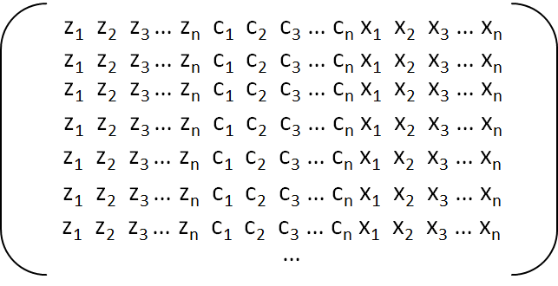
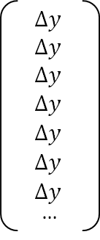
Model Overview
STEP 1
STEP 2
STEP 3
STEP 4
Input Data
Input Historical Revenues
Train model by change in total revenue
Predict Future Revenue
Input external data as Z,
competitor data as C,
and internal data as X
Input historical revenues of Walmart stores as Y
Use the trained model to predict incremental revenue if a new Walmart opens in a particular zip code
Train the model using the change in total revenue before and after a new Walmart has opened
Notes:
Let’s dive into our model. We put three kinds of data into our model, the external data, such as the demographic and geographic data as Z, the competitor data as C, and the internal data, such as variables of each stores as X. Then step 2, we put the revenue increase as Y. Step 3, we calculate the Y into the change of total revenue, that is how much the revenue had increased 6 months before and 6 months after a new store was opened.
Then finally we use the real external data Z of all the zip codes, and then we could predict the future revenue gain if we open a new Walmart in each zip code by this predictive model. Later on we will discuss more further into each steps of the model.

Slide 9
Model Overview
Why Use a Single Model?
1
Eliminates the need to normalize different models
2
Avoid making hard boundary decisions too early
3
Simplification can likely improve model accuracy
Notes:
As you can see, we only have one model.
The good thing about a single model is that compare to having two or three models, we eliminate the need to smoothen or normalize each dimensions of different models.
Also, we could avoid making hard boundary decisions too early if we have only one model. That way we don’t need to decide which model to run our new data on. and 2 models might create some things that make sense stand alone but not when we combine two models.
In addition, simplification always improve model accuracy.
Next on, Jie Ji will dive deeper into the data we first input into our model.

Slide 10

Input Data
All input data are captured before Walmart opens new stores
External Data
Internal Data
Competitor Data
All different categories’ competitor revenues, location
Demographics Data
Census data of the zip codes
Sales Data
Walmart sales data from all stores at shopping cart level
Store Data
All Walmart store data such as size, number of employees, etc
Notes:
Thank you Rory. After making the outline of our model, our team then decide what kind of data should be input to train the model. Each record we put into the model is a zip code and its related features. We restrict the time length to 4 years, and include the zip code that opened a new Walmart store in this period of time. The reason why we choose past 4 years as standard is that there are several hundred new Walmart stores opened from 2016 to 2019, and these data are not very long ago thus qualified for analysis.
We have mainly two kinds of data, external data and internal data. Internal data includes sales data like from all Walmart overall sales data to shopping cart level data, and store data such as supermarket size, number of employees and etc. that covers all the Walmart stores. And for the external data, we have two parts, demographics data and competitor data.

Slide 11

Input Data Z (Demographics)
Each record of the Z matrix is the demographic data or external data of that zip code. There is no fuzzy matching for Z data.
Features of Z data include::
Population
Population density
Zip code area size
Average age
Income level
Average family size
Number of food stamps given out
…
Notes:
For demographics data Z, they are the exact description of a zip code in certain fields. For example, we include population, population density, age distribution, income and other several fields as input. Technically, We can gather most of these accurate demographic data form public resources, but for competitor data, it would be a bit difficult to collect.

Slide 12
Input Data C (Competitors)
Competitor Measure = Total Revenue in Zip Code - Walmart Revenue
Sources: Census, credit card issuers such as Visa (costly)
Competitor measure by category (e.g. groceries, homegoods, pharmacies)
Total revenue of the same competitor category within a zip code level area
Known revenue of Walmart stores within zip code
Notes:
First, we need to categorize Walmart’s competitors. The competitors not only include supermarkets like Costco and BestBuy, but also other categories like groceries, home appliance markets and other specialized supermarkets. And then, we will collect data for our competitors. We believe that we are almost impossible to gather the competitor data on a store basis, so we will collect the data on a category basis. We will include variables such as the number of competitors of a certain category in this zip code, and we can buy data from third parties like VISA to calculate the total revenue of a category in a zip code.
Next on, Angela will talk to you about internal data X

Slide 13
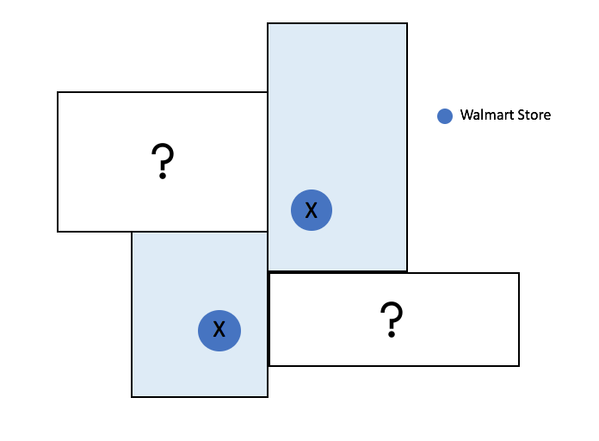
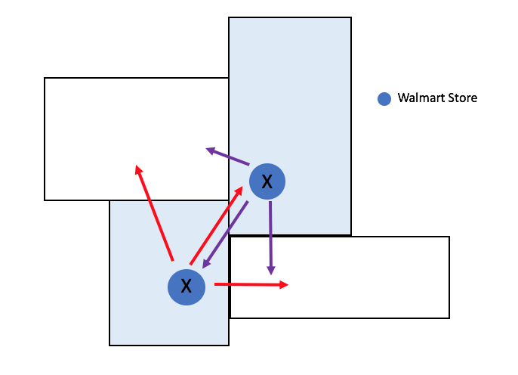
Input Data X (Internal)
Allocation
How much should be allocated to other zip-code areas?
How much will X change in the original zip code where the store is located at?
Missing X data for some zip codes
Notes:
I would like to talk about the last part of our input data, internal data x. Initially, we did not include x as part of our model thinking that a new store would not have this kind of internal data that can be fed into the model for prediction. However, there are many internal data fields that we believe can have somewhat of impacts on revenue. This led to questions that these two graphs represent here: how do we deal with zip codes that do not have a store in the past and therefore missing internal data? If we want to allocate X from existing stores, how much should be allocated? How will it change the original store data?

Slide 14
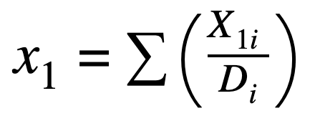
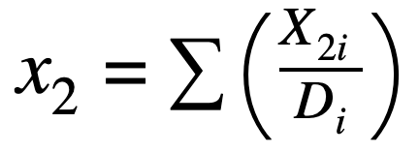

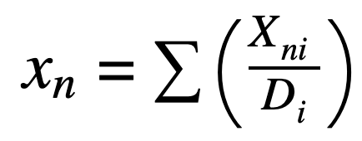
Fuzzifying Input Data X
Store Size
Employees
Square Feet
…
Number of Total
Transactions
For each data record (zip code):
Take the center of each zip code (exact latitude and longitude given) as a starting point
Calculate the distance between the center and other Walmart stores
Divide corresponding Xs by distance
Take a sum of step 3
...
Notes:
We decided to go with fuzzification. Fuzzification is the process of converting a crisp input value to a fuzzy value that is performed by the use of the information. Let me walk you through the steps we took to create a fuzzy set of Xs. We would like to take the center, in terms of geography, of all zip code areas as a starting point and measure the distance between the center to all Walmart stores. Then use internal data from each store to divide by the distance measured to make the allocation and take a sum of all these for a final value. Simply speaking, this result gives the sum of all Walmart stores of a constant divided by the distance from a particular zip code center to the stores. The internal data we consider include store size, number of employees, number of transactions…

Slide 15
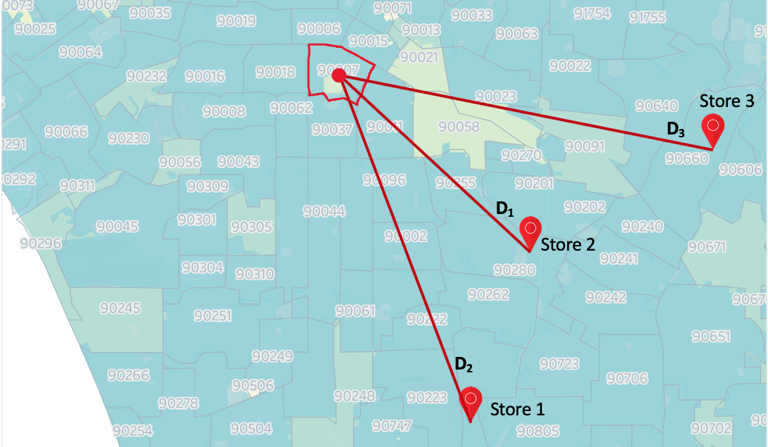
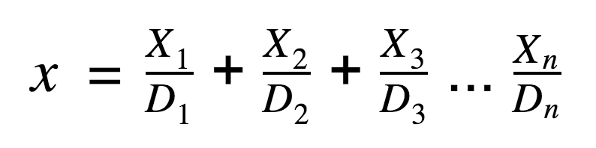
Example of Fuzzification
Notes:
Here is an example. For the zip code area where USC is located at, 90007, there is no Walmart store. For a particular field taken from internal data, we would use that particular X from each Walmart store and divide by the distance from the center of 90007 to the stores. Here shows the nearest three stores but the formula would continue to every single store in the States. When the distance becomes too large, the value would become insignificant (close to 0), which makes sense as customers are more likely to go to stores that are closer in distance.

Slide 16
Input Data Selection: PLS
Partial Least Squares (PLS)
With limited records, we would like to select only significant fields since we need more records than unknown parameters to build a model.
PCA is not the best practice for supervised models because it tends to ignore dependent variables.
PLS standardizes input variables first and finds different combinations which maximize inter-class variance. This way we can reduce dimension for the supervised model. With the limited number of records, PLS will help select the input data fields that should be fed into the model instead of all fields considered.

Slide 17

Target Y
Revenue
Walmart Revenue in a zip code
R
Our goal is to maximize the incremental increase of the total revenue.
R is the total revenue after open a new Walmart, R′ is the revenue before it.
𝚫y = R - R′
R′
Time
New Walmart Added
Notes:
Now, let’s talk about how we define the target.
As it was mentioned previously, we not only focus on finding the similar demographic pattern, but value the influence on the revenue as a new Walmart is added.
Since our goal is to maximize the performance after opening a Walmart in a zip code, we aim at the change of the revenue rather than just the total amount of it.
We believe that using revenue increase as the target would help us on more directly finding the potential or undiscovered earning we could make in a zip code.
For example, once we have a new Walmart opened, then our target delta y can be calculated by R subtracting R’, and the R stands for the total revenue during a period of time after the store is opened, and R’ is the opposite, which is the total revenue before it within the same amount of time.

Slide 18
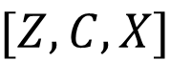
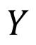
Model Predicting Process
Data Records (Zip Code)
Zip code | Incremental Revenue
90007 | $ 13.3M
90089 | $ 11.8M
50000 | $ 11.6M
60000 | $ 10.0M
30000 | $ 9.2M
40000 | $ 7.7M
... | ...
Predictive Model
Notes:
And so far, we’ve gone through all the fields in our data matrix.
Once we trained the model by historical records, we are all set for the prediction.
In the predicting process, each zip code that we consider having a new store, will have its own record about the demographic factors Z, competitor information C, and the internal data X.
We’ll feed all the zip codes and associated records into our model, and we expect it to output a list of predicted changes in revenue corresponded to all the candidate zip codes.
Then finally, our deliverable is the sorted list of the output from the model, indicating the most potentially profitable zip codes and with estimated revenue it would make as we open a new store in it.

Slide 19


Limitations
Location Accuracy
There might be better ways to define and measure the “center”
Data Records
Trade-off between enough data records and up-to-date data that can reflect the current internal situation and demographic characteristics

Slide 20

Future Work
Exact location
Business insights
Cost
Consider costs to make more informed business decisions for Walmart such as the most profitable location
Data
Capture more data records in the future

Slide 21
THANK YOU!
Questions?

